Slide 1





GeOsm/LISN
Location Intelligent Social
Network

Slide 2

DevOps Engineer at GeOsm
CTO & CO-Founder of BBrain
How a Devps get into Flutter
WHO AM I ?

Slide 3

t into Flutter

Slide 4

APERÇU DU PROJET

Slide 5

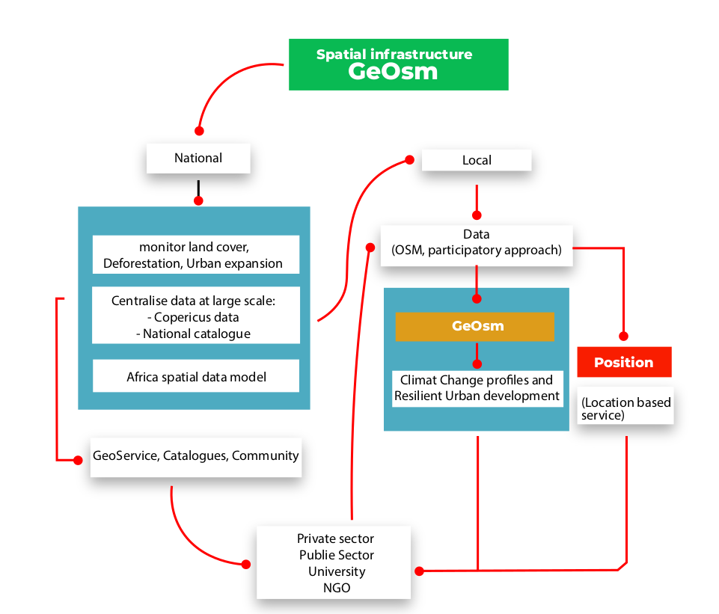
Open Data Infrastructure
Mapping services
Geospatial Innovation Ecosystem
How a Dps get into Flutter

Slide 6
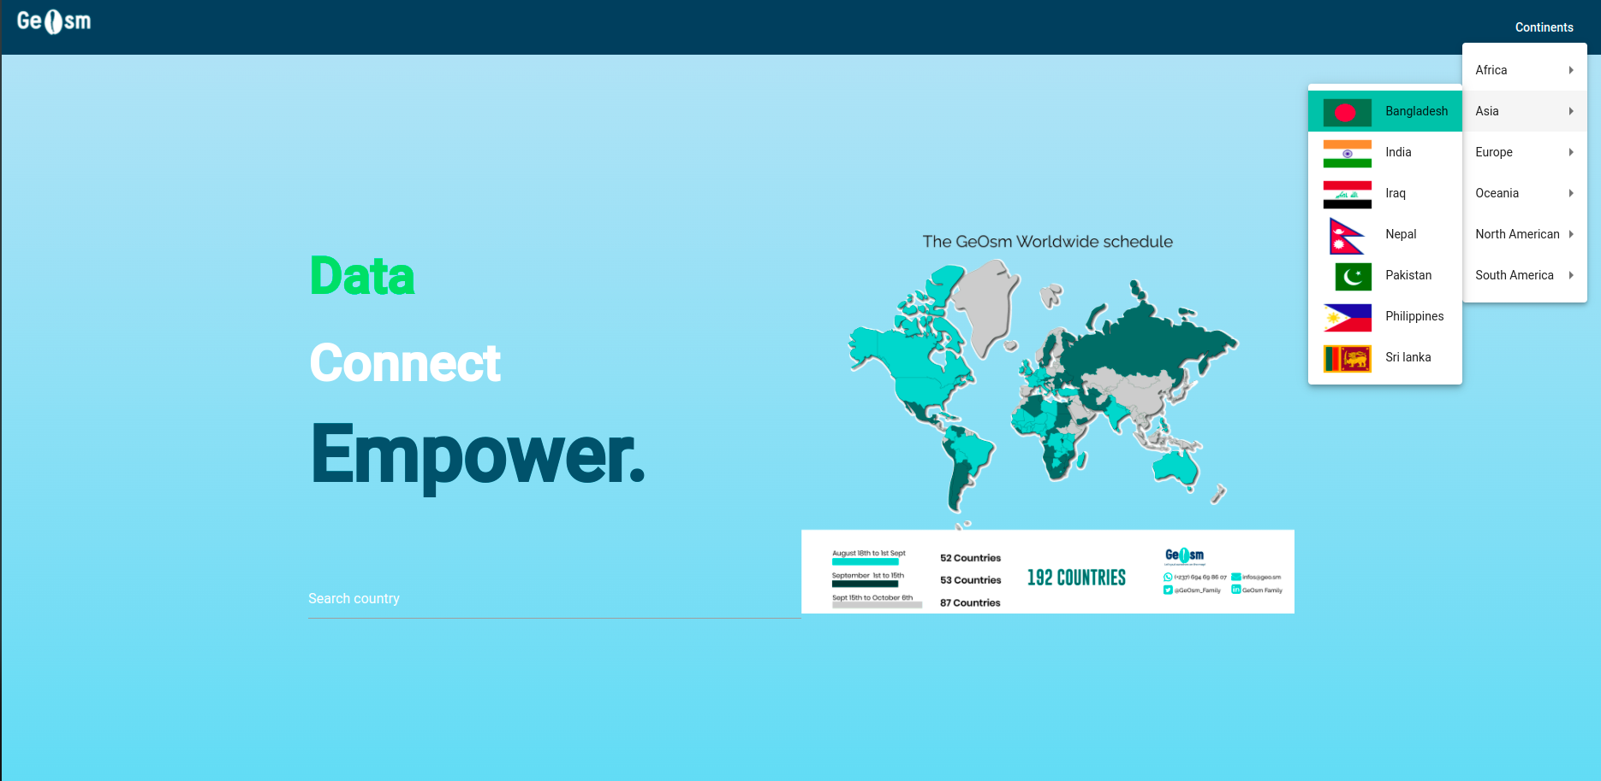
LE PROJET GEOSM/LISN
LISN– Location Intelligent Social Network

Slide 7
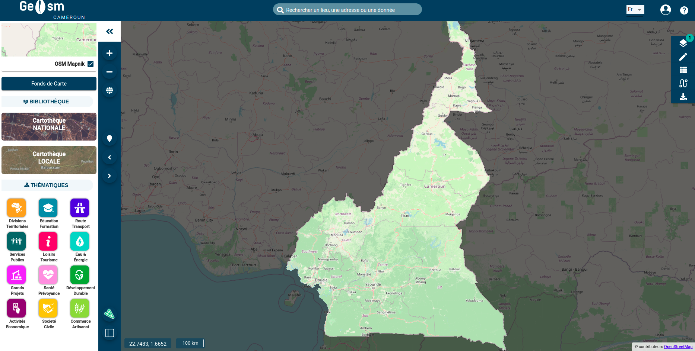
LE PROJET GEOSM/LISN
LISN– Location Intelligent Social Network

Slide 8
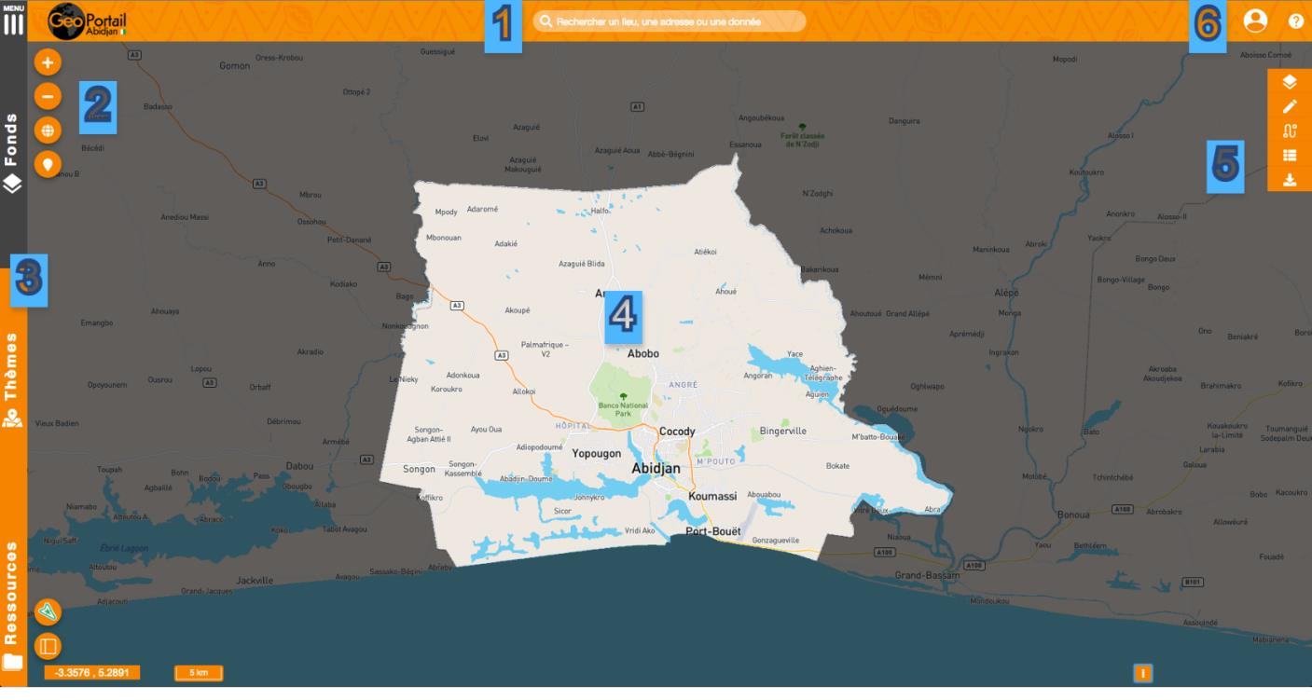
LE PROJET GEOSM/LISN
LISN– Location Intelligent Social Network

Slide 9
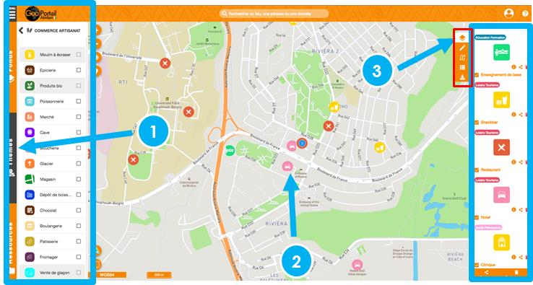
LE PROJET GEOSM/LISN
LISN– Location Intelligent Social Network

Slide 10
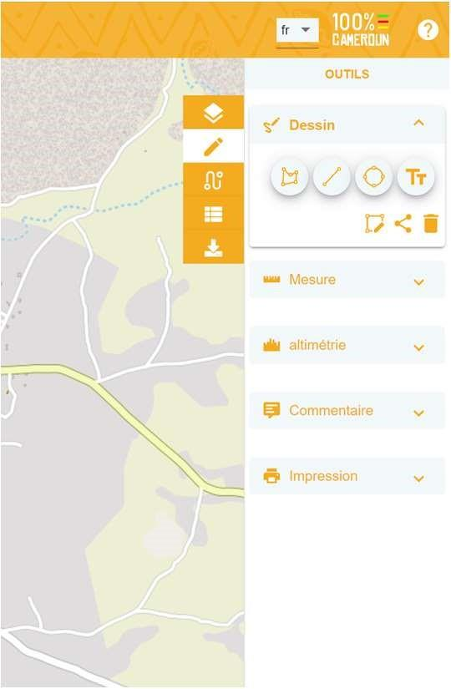
LE PROJET GEOSM/LISN
LISN– Location Intelligent Social Network

Slide 11
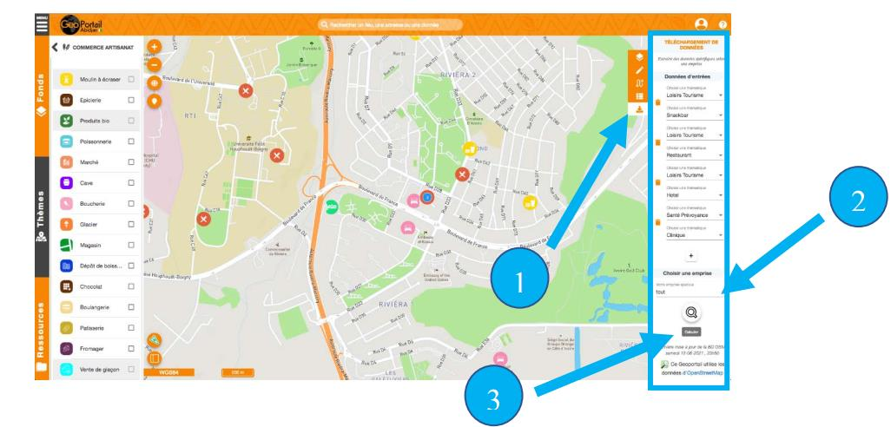
LE PROJET GEOSM/LISN
LISN– Location Intelligent Social Network

Slide 12
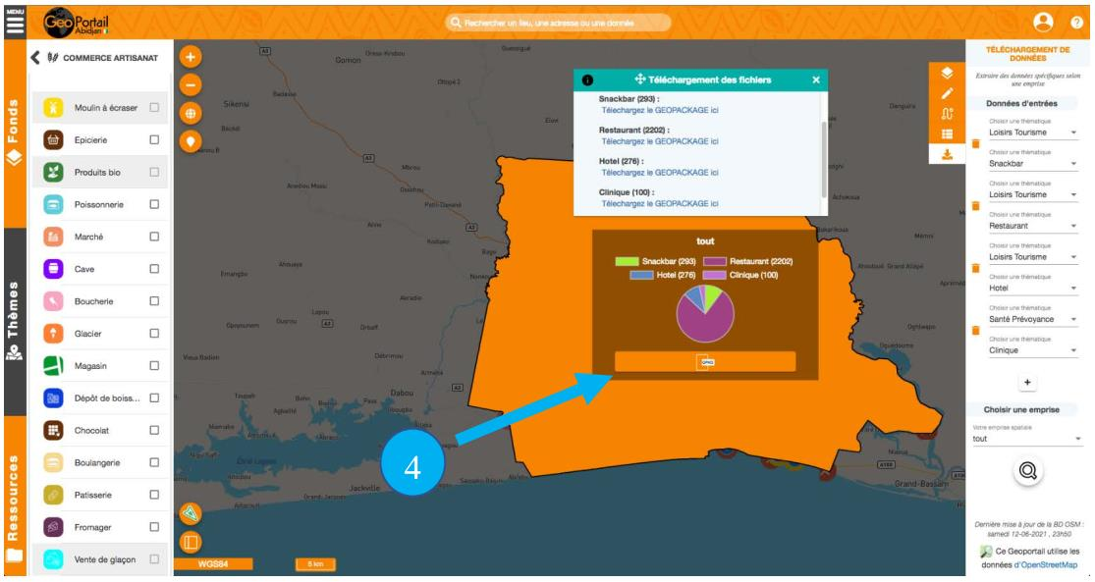
LE PROJET GEOSM/LISN
LISN– Location Intelligent Social Network

Slide 13
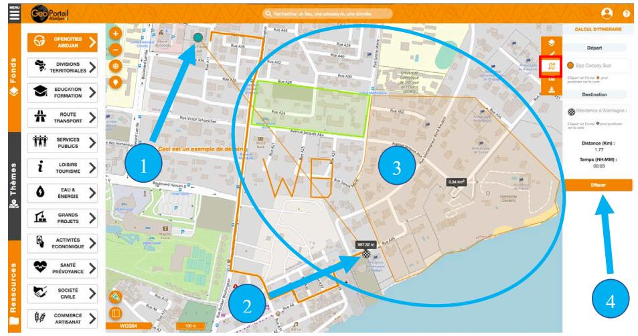
LE PROJET GEOSM/LISN
LISN– Location Intelligent Social Network

Slide 14
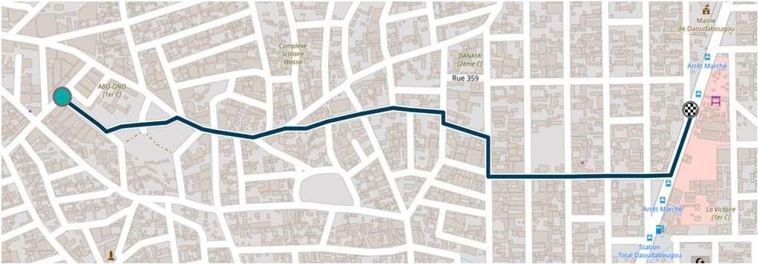
LE PROJET GEOSM/LISN
LISN– Location Intelligent Social Network

Slide 15
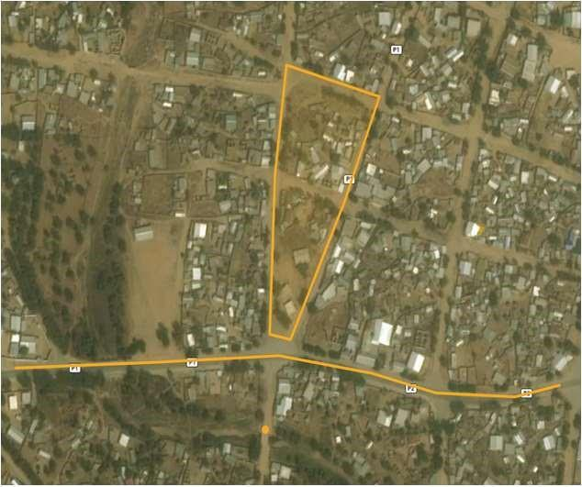
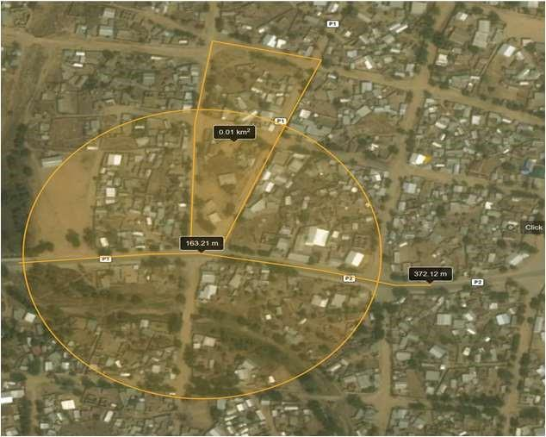
LE PROJET GEOSM/LISN
LISN– Location Intelligent Social Network

Slide 16
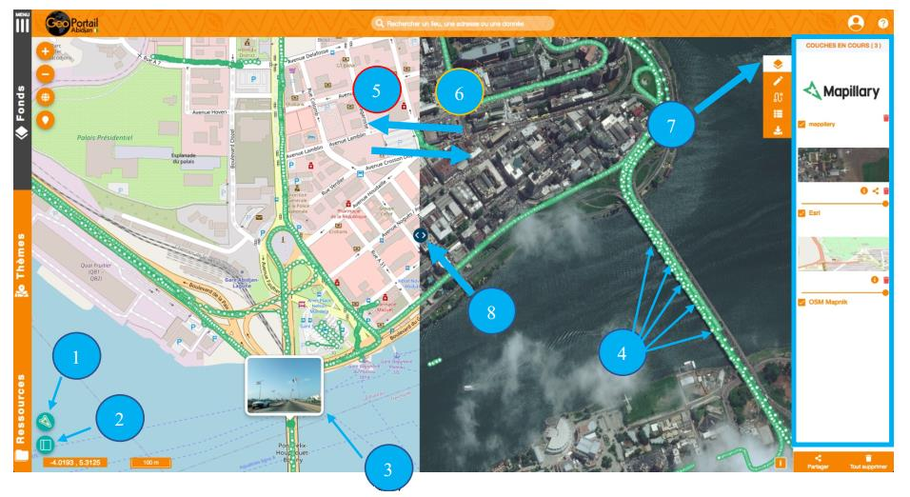
LE PROJET GEOSM/LISN
LISN– Location Intelligent Social Network

Slide 17

LE PROJET GEOSM/LISN
LISN - Abréviation pour Location Iintelligent Social Network
Un reseau social base sur la map
Les objectifs généraux du projet
Objectif A: Data
Objectif B: Connect
Objectif C: Empower
LISN– Location Intelligent Social Network

Slide 18

CONTRIBUTION AUX OBJECTIFS DE
DÉVELOPPEMENT DURABLE DES NATIONS UNIES
LISN– Location Intelligent Social Network

Slide 19
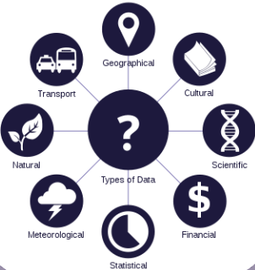
OBJECTIF A
Data
OpenData
Thematiques
Collection
LISN– Location Intelligent Social Network

Slide 20
OBJECTIF B
Connect
Dialogue Spacial
Connecter des acteur de l’ecosysteme digital
LISN– Location Intelligent Social Network

Slide 21
OBJECTIF C
Empower
Help decision makers
LISN– Location Intelligent Social Network

Slide 22

Technologies

Slide 23
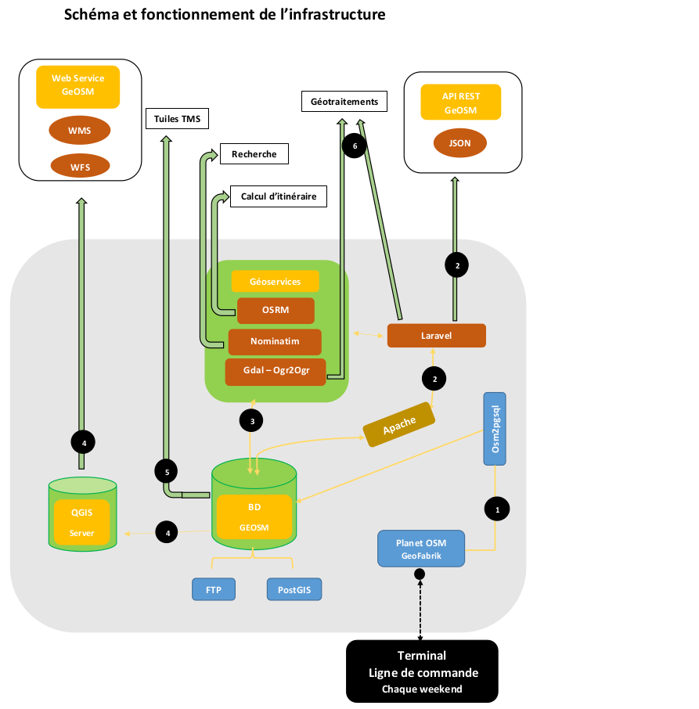
OBJECTIF B
LISN– Location Intelligent Social Network

Slide 24
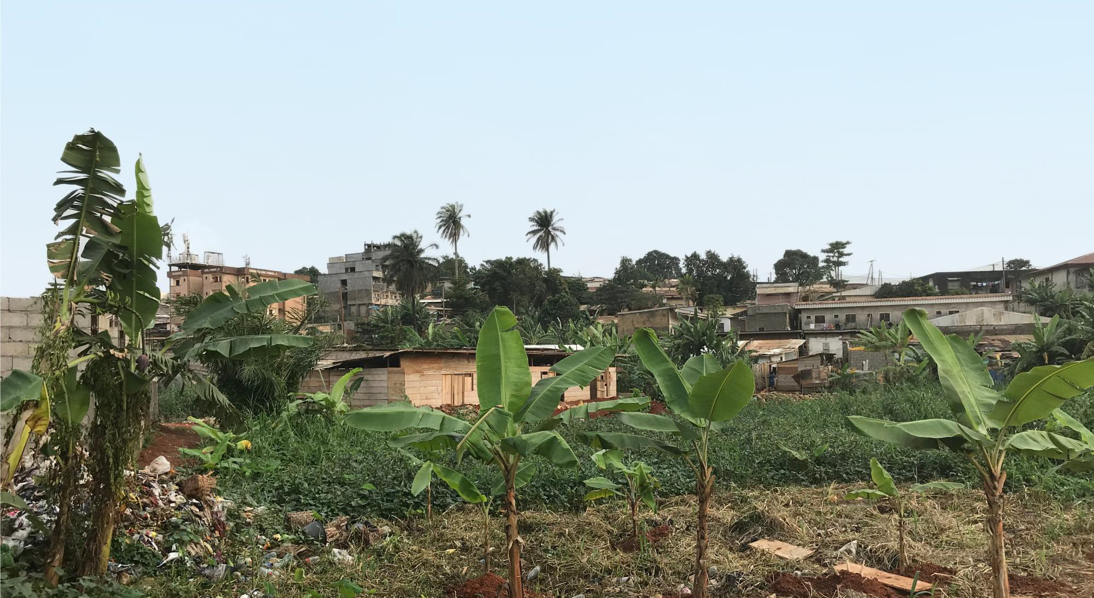
MERCI POUR VOTRE ATTENTION

